Slide 1


Extra-Tropical Storm Surge (ETSS 1.5)
Pre-Implementation Briefing
May 22, 2014
Huiqing Liu and Arthur Taylor
MDL/NWS/NOAA

Slide 2
Outline
What is ETSS?
What has changed?
ETSS1.0 vs 1.5 Architecture
Testing, Dissemination, Coordination, Misc
What does the user see?

Slide 3
What is ETSS
The Extra Tropical Storm Surge Model is a modification of the SLOSH model which uses GFS winds to predict storm surge based on large extra-tropical storms
Produces Coastal Guidance
4 times a day (00z, 06z, 12z and 18z) when the GFS winds are available (roughly 4 hours 50 min after nominal forecast time)
On NDFD CONUS Grid (merges 3 extra-tropical basins)
On NDFD Alaska Grid (merges 3 extra-tropical basins)

Slide 4


Extra Tropical Storm Surge I/O resolution upgrade
Project Status as of 05/20/2014
G
Scheduling
G
Project Information and Highlights
Milestone (NCEP) | Date | Status
Initial EE setup (NCO Support) | 4/22/2014
MDL testing complete | 5/6/2014
Code delivered to NCO | 5/6/2014
Technical Information Notice Issued | N/A?
CCB approve parallel data feed | TBD
Parallel testing begun in NCO | TBD
Real-Time Evaluation Ends | TBD
IT testing begins | TBD
IT testing ends | TBD
Management Briefing | TBD
Implementation | FY14Q3
Leads: Arthur Taylor (MDL)
Scope:
SPA Bugzilla 108 – Move to vertical structure and reintroduce the error messages to avoid ‘silent failure on 1/27/2014’
Replace the forcing used by the ETSS model from GFS GRIB-1 1 degree winds to GFS GRIB-2 0.5 degree GFS winds. --- See 3/10/2014 email about need to move to GRIB2
Output of the ETSS model on both 5 km and 2.5k m NDFD CONUS grids; as well as on the 6 km and 3 km NDFD Alaska grids.
Correct the Alaska mask file used to provide guidance in the south Bering Sea.
Expected Benefits:
Bug fixes (Diagnostics and better guidance for south Bering Sea)
Take advantage of more accurate wind guidance to create more accurate storm surge guidance for extra-tropical storms
Updates the resulting guidance to the resolution that the WFO’s are currently working on.
G
Issues/Risks
G
Finances
Issues:
Is a TIN needed if we are doing a transparent (to end user) upgrade to the model?
Risks:
Mitigation:
Associated Costs: MDL in house maintenance.
Funding Sources: NA
Management Attention Required | Potential Management Attention Needed | On Target
R
Y
G
v1.0 9/14//07
Notes:
4
4

Slide 5
ETSS 1.5 Enhancements
Move to vertical structure and reintroduce diagnostic messages to avoid silent failures similar to the one that occurred on 1/27/2014
Replace the GFS GRIB-1 1 degree winds to GRIB-2 0.5 degree winds
More accurate wind guidance should produce more accurate storm surge guidance
Correct the mask file used to merge Alaska basins
Better guidance for south Bering Sea
Extend the window used to extract GFS winds to fully cover the Arctic extra-tropical basin
Improves the wind forcing fields for the Arctic extra-tropical basin for diagnostics
No impact on output surge values as the missing area was overland
Generate ETSS model output on both the 5 km and 2.5 km NDFD CONUS grids; as well as on the 6 km and 3 km NDFD Alaska grids
Provides WFO’s with guidance at the resolution they are now working with
Impact: Increase of computer memory from 100 MB to 200 MB

Slide 6
ETSS 1.5 running at 00z, 06z, 12z and 18z
Kick off Cron Job at
04:50z, 10:50z, 16:40z ,22:40z ,
for GFS output data time delay
runETSS.sh
Prepare to define GFS data source and Model working directory
Kick off setup.sh and check.sh to copy GFS data needed by ETSS. Also kick off jgfs_stormsurge.ecf
Kick off script exgfs_stormsurge_sh.ecf
Submit job JGFS_STORMSURGE
Prepare GFS data and run mdl_c10_gen mdl_cy_puv10
gfs_stormsurge_poe.sh run
mdl_ext_6h
Run mdl_mdlsurge
mdl_gridmerge
Output Data
Pre processing GFS wind data
mdl_c10_gen extract past forcing fields
mdl_cy_puv10 extract current and forecast forcing fields
Assign 1 cpu to run ETSS 1.5 model in Gulf of Mexico basin and the other 1 cpu to run in other 5 basins
Post processing output data
mdl_mdlsurge handle stations output
Mdl_gridmerge handle whole grid output
Stations output files are in text format
Whole grid output files are in GRIB-2 format

Slide 7
Architecture ETSS1.0
Data Source: /com/gfs/prod/gfs.${PDY}
Data Destination: ${MDLTEST_DIR}/com/gfs/prod/gfs.${PDY}
Model Working Directory: ${MDLTEST_DIR}/tmp
Step 0: “runETSS_live.sh YYYYMMDD XX N”
a) Copy GFS input data from /com to ${MDLTEST_DIR}/com
b) Copy ETSS 1.0 output data from /pcom to ${MDLTEST_DIR}/pcom
c) Call jobs/JGFS_STORMSURGE
Step 1: jobs/JGFS_STORMSURGE
a) Set environment variables and call ‘mpirun.lsf scripts/exgfs_stormsurge.sh.ecf’
via call scripts/exgfs_stormsurge.lsf
Step 2: scripts/exgfs_stormsurge.sh.ecf “prepare GFS data step”
a) Prepare GRIB-1 1 degree resolution data before running extraction programs
b) Run mdl_c10_gen to extract past (60 hours)surface pressure, and wind vector
fields from GRIB-1 1 degree data
c) Run mdl_cy_puv10 to extract current and forecast(96 hours) surface pressure,
and wind vector fields from GRIB-1 1 degree data

Slide 8
Architecture ETSS1.5
Data Source: /com/gfs/prod/gfs.${PDY}
Data Destination: ${MDLTEST_DIR}/com/gfs/prod/gfs.${PDY}
Model Working Directory: ${MDLTEST_DIR}/tmp
Step 0: “runETSS.sh YYYYMMDD XX”
a) Copy GFS input data from /com to ${MDLTEST_DIR}/com
b) Copy ETSS 1.0 output data from /pcom to ${MDLTEST_DIR}/pcom
c) Call myEcf/jgfs_stormsurge.ecf to call jobs/JGFS_STORMSURGE via bsub
Step 1: jobs/JGFS_STORMSURGE
a) Set environment variables and call ‘mpirun.lsf scripts/exgfs_stormsurge.sh.ecf’
Step 2: scripts/exgfs_stormsurge.sh.ecf “prepare GFS data step”
a) Prepare GRIB-2 0.5 degree resolution data before running extraction programs
b) Run mdl_c10_gen to extract past (60 hours)surface pressure, and wind vector
fields from GRIB-2 0.5 degree data
c) Run mdl_cy_puv10 to extract current and forecast(96 hours) surface pressure,
and wind vector fields from GRIB-2 0.5 degree data

Slide 9
Architecture ETSS1.0
Step 3: scripts/exgfs_stormsurge.sh.ecf “run ETSS1.0 model step”
a) Call ush/gfs_stormsurge_poe.sh assign 1 CPU to run extra-tropical storm surge
model in Gulf of Mexico basin and the other 1 CPU to run in other 5 basins.
*) Bi-linear interpolate Atmospheric forcing fields (surface pressure, and U and V
wind vector fields) from GFS 1.0 degree grids to SLOSH extra-tropical basin
grids
*) Generate surge archive files: 1)sshistory.${cyc}${bsn} (station output)
2)ssgrid.${cyc}${bsn} (whole domain)

Slide 10
Architecture ETSS1.5
Step 3: scripts/exgfs_stormsurge.sh.ecf “run ETSS1.5 model step”
a) Call ush/gfs_stormsurge_poe.sh assign 1 CPU to run extra-tropical storm surge
model in Gulf of Mexico basin and the other 1 CPU to run in other 5 basins.
*) Bi-linear interpolate Atmospheric forcing fields (surface pressure, and U and V
wind vector fields) from GFS 0.5 degree grids to SLOSH extra-tropical basin
grids
*) Generate surge archive files: 1)sshistory.${cyc}${bsn} (station output)
2)ssgrid.${cyc}${bsn} (whole domain)

Slide 11
Architecture ETSS1.0
Step 4: scripts/exgfs_stormsurge.sh.ecf “post processing output data step”
a) Run program mdl_mdlsurge to extract storm surge output at stations
sshistory.${cyc}${bsn} to AFOS format output mdlsurge.${cyc}{bsn}
b) Run program mdl_gridmerge to merge grids
=> 3 Alaska area basins (ssgrid.${cyc}a,ssgrid.${cyc}z and ssgrid.${cyc}k) are
merged to GRIB-2 NDFD Alaska grids:
6 km NDFD Alaska grids mdlsurgegrid.${cyc}ala
* need mask file: parm/mdl_etalaska.bin (6 km resolution)
=> 3 CONUS area basins (ssgrid.${cyc}e,ssgrid.${cyc}g and ssgrid.${cyc}w) are
merged to GRIB-2 NDFD CONUS grids:
5 km NDFD CONUS grids mdlsurgegrid.${cyc}con
* need mask file: parm/mdl_etconus.bin (5 km resolution)
c) Run program tocgrib2 to add WMO headers to GRIB-2 files
* mdlsurgegrid.${cyc}${area}===>grib2.mdlsurgegrid.${cyc}${area}

Slide 12
Architecture ETSS1.5
Step 4: scripts/exgfs_stormsurge.sh.ecf “post processing output data step”
a) Run program mdl_mdlsurge to extract storm surge output at stations
sshistory.${cyc}${bsn} to AFOS format output mdlsurge.${cyc}{bsn}
b) Run program mdl_gridmerge and mdl_gridmerge_2.5km to merge grids
=> 3 Alaska area basins (ssgrid.${cyc}a,ssgrid.${cyc}z and ssgrid.${cyc}k) are
merged to GRIB-2 NDFD Alaska grids:
6 km NDFD Alaska grids mdlsurgegrid.${cyc}ala (mdl_gridmerge)
3 km NDFD Alaska grids mdlsurgegrid.3km.${cyc}ala (mdl_gridmerge_2.5km)
* need mask files: parm/mask_alaska_6km.bin (6 km resolution)
parm/mdl_etalaska.bin (3 km resolution)
=> 3 CONUS area basins (ssgrid.${cyc}e,ssgrid.${cyc}g and ssgrid.${cyc}w) are
merged to GRIB-2 NDFD CONUS grids:
5 km NDFD CONUS grids mdlsurgegrid.${cyc}con (mdl_gridmerge)
2.5 km NDFD CONUS grids mdlsurgegrid.2.5km.${cyc}con (mdl_gridmerge_2.5km)
* need mask files: parm/mask_conus_5km.bin (5 km resolution)
parm/mdl_etconus.bin (2.5 km resolution)
c) Run program tocgrib2 to add WMO headers to GRIB-2 files
* mdlsurgegrid.*${cyc}${area}===>grib2.mdlsurgegrid.*${cyc}${area}

Slide 13
Testing
MDL ran it from end of April 2014 to now
Compared the results with that of ETSS1.0

Slide 14
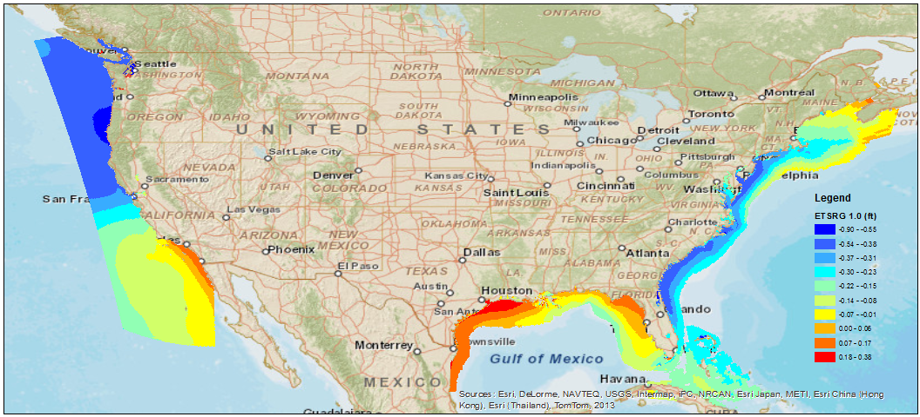
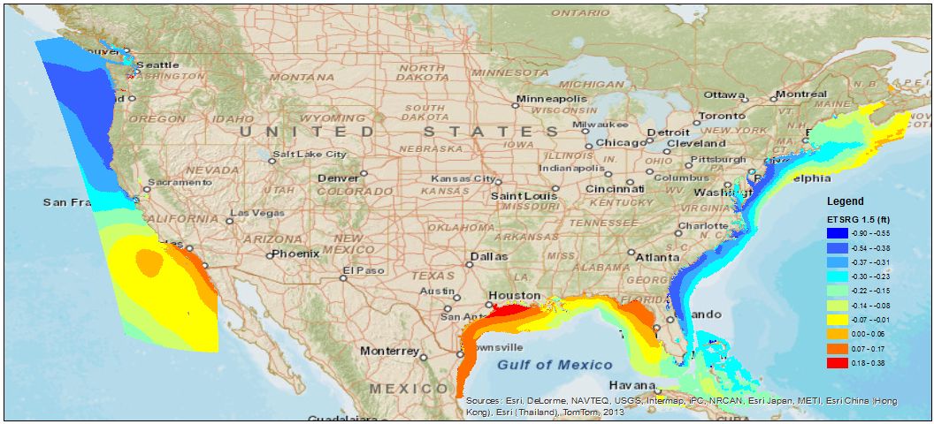
Testing-20140511 00Z TOP:ETSS1.0 and Bottom ETSS1.5

Slide 15
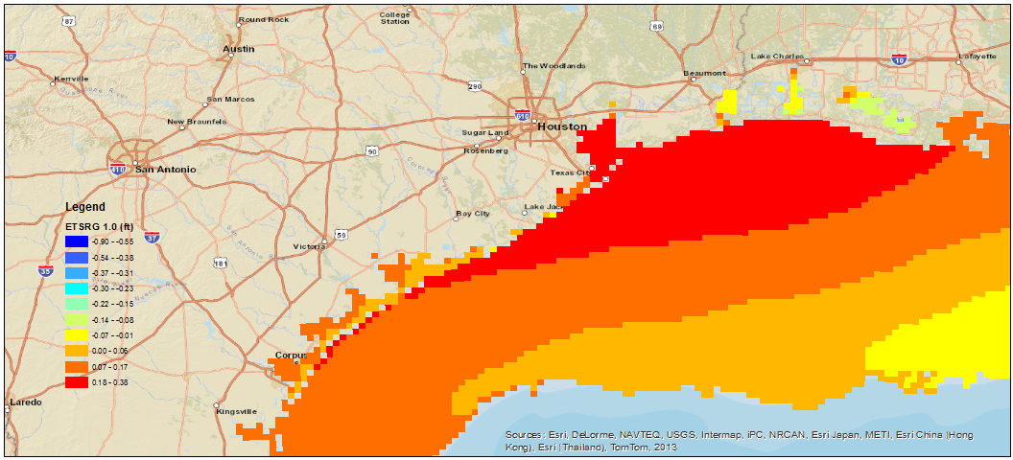
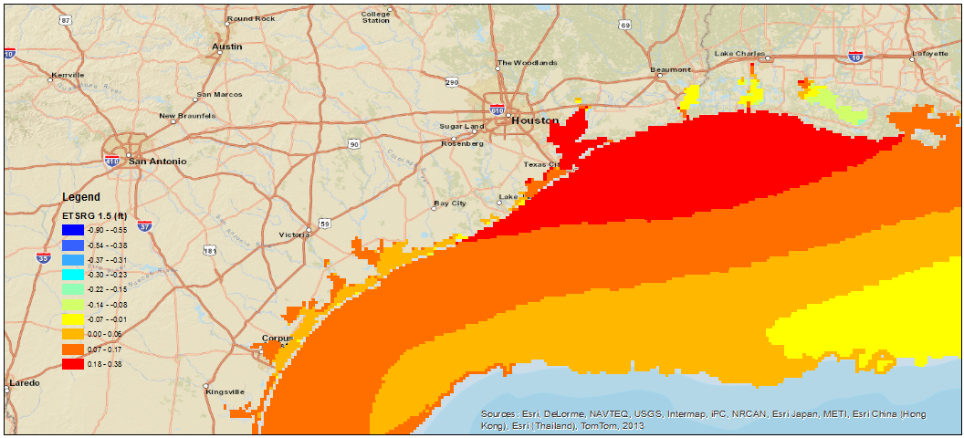
Testing-Zoom In

Slide 16
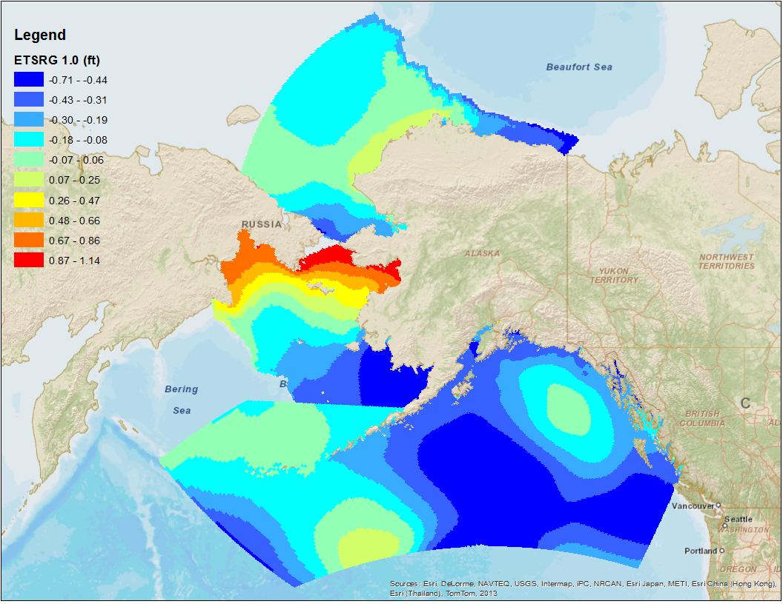
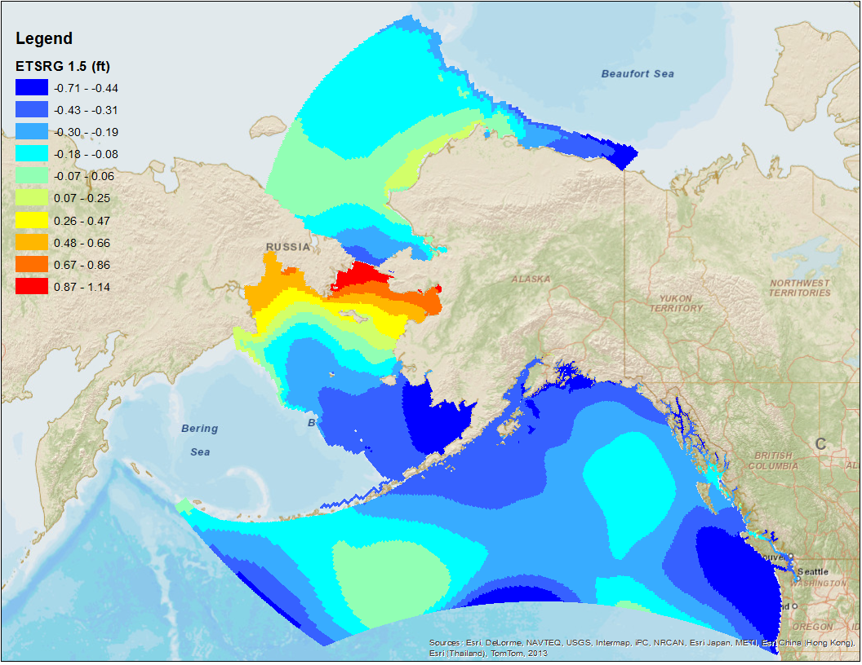
Testing-20140511 00Z TOP:ETSS1.0 and Bottom ETSS1.5

Slide 17
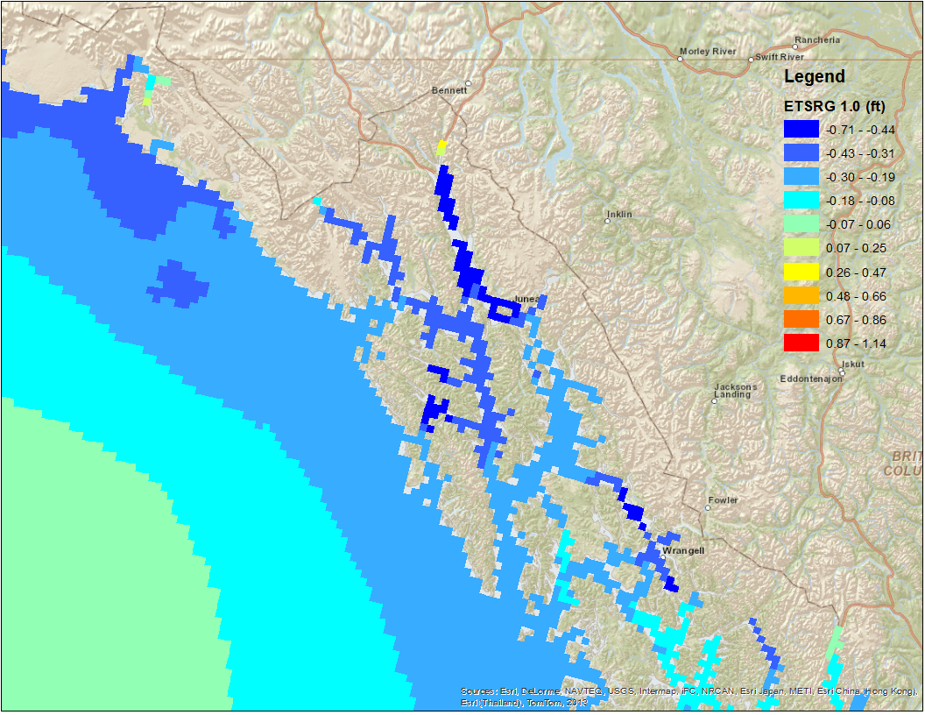
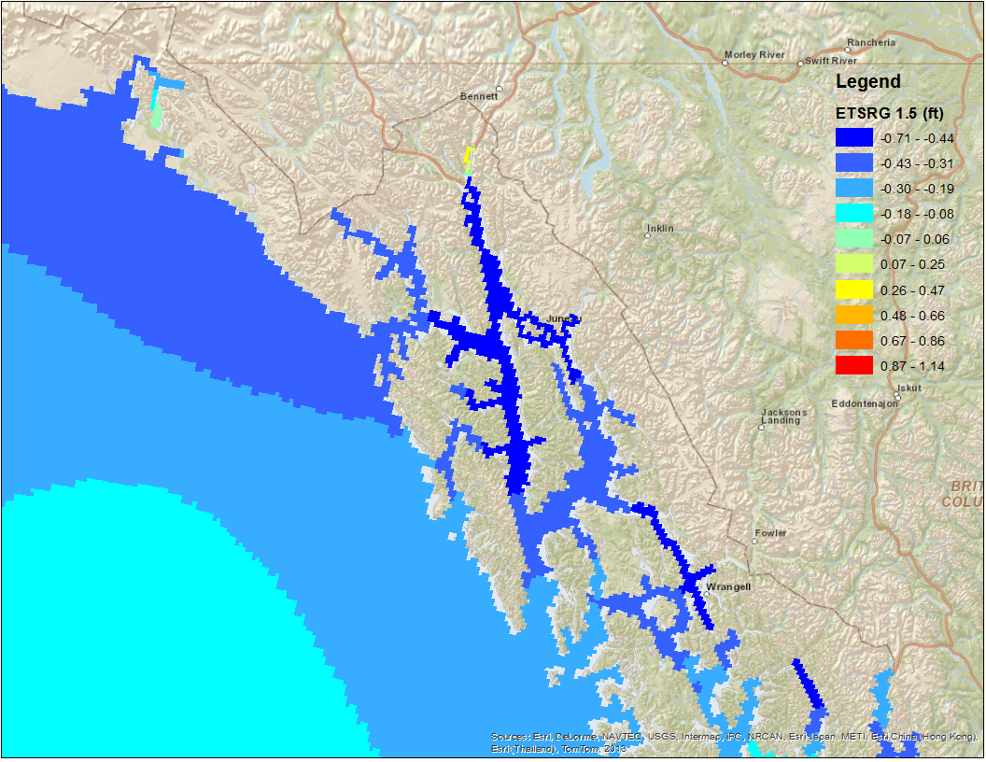
Testing-Zoom In

Slide 18
Dissemination
File size
(100 MB for CONUS grids and 50 MB for ALASKA grids 4x a day)
RC
xx
GRIB2 headers
xx
Notification
TIN (OCWWS John Kuhn update)
Evaluation Team
NCO, MDL, OCWWS

Slide 19
Miscellaneous
Repository:
https://collaborate3.nws.noaa.gov/svn/etss/
https://collaborate3.nws.noaa.gov/projects/etss/repository
Summary WCOSS resource impact:
*) mdl_gridmerge memory usage from 100 to 200
Questions:
1) Do we need new WMO headers if we're just changing grid resolution?
Missing: RFC, Charter, TIN

